Slide 1


Slide 2





Description
"Unbox Holidays" offers holiday decoration blind boxes that bring a unique twist to seasonal decorating. Each box, inspired by the joy of holidays, is filled with surprises to fit a variety of decorating styles. Our goal is to deliver a piece of holiday cheer to every home.
The website is straightforward and user-friendly, with simple login and signup processes, and an easy-to-navigate profile area for managing accounts and subscriptions. With secure payment processing and efficient API integrations, we ensure a smooth and enjoyable experience for every customer, helping you connect with the heart of our brand.
Subscription and Single Purchase Options
Interactive Chatbot
Customization Questionnaire
Custom Decor Visualizer

Slide 3


APIs
Address
validation and autocomplete APIs
Authentication APIs
Payment APIs
Stax
Square
Stripe
Authorize.net
Adyen
AddressComplete APIs from CanadaPost
PostGrid APIs
EasyPost APIs
Google Sign-in

Slide 4


APIs
Chatbot APIs
Image Generator APIs
ChatBot
Dialogflow API
Google Chat API
Bot Libre
Wit.ai
OpenAPI
ImgCreator
ZMO.AI
Midjourney

Slide 5
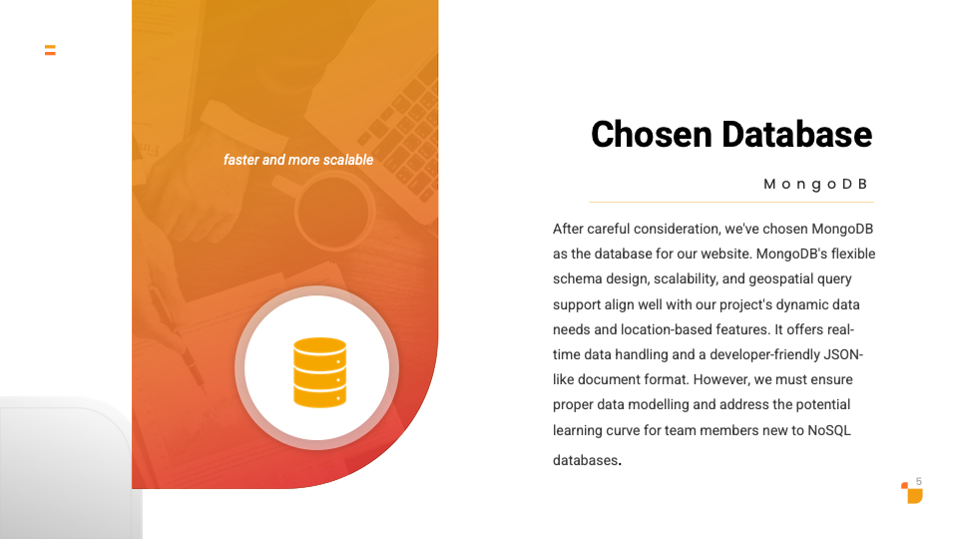

Slide 6

Mock-ups/Prototype
Click here for the Figma version of the mock-ups/ prototype.

Slide 7
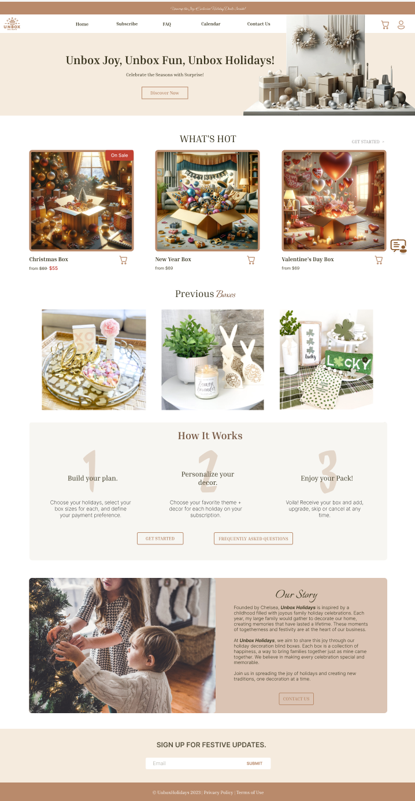
Homepage
Our homepage is designed for easy user navigation and engagement, offering:
Current Holiday Selection: Shows the boxes for the upcoming three holidays available for single purchase.
Previous Boxes Showcase: Displays past boxes to give a sense of the variety and style of our offerings
How it Works: A concise three-step guide explaining the process of using our service.
Our Story: A brief section sharing the brand’s background and mission.

Slide 8
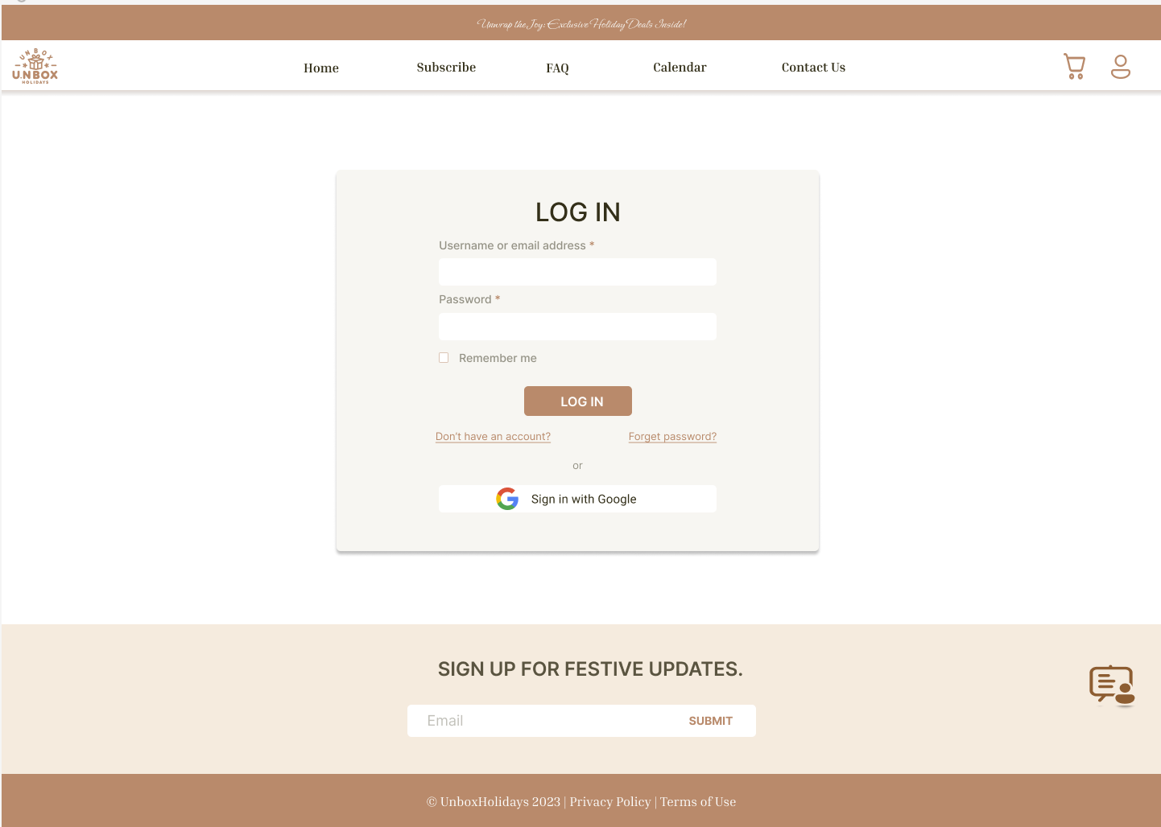
Login Page
The login page is straightforward, ensuring that users can quickly access their accounts to explore and engage “Unbox Holidays”, our holiday decoration blind boxes website.
Also, the user can login using the Google account.

Slide 9
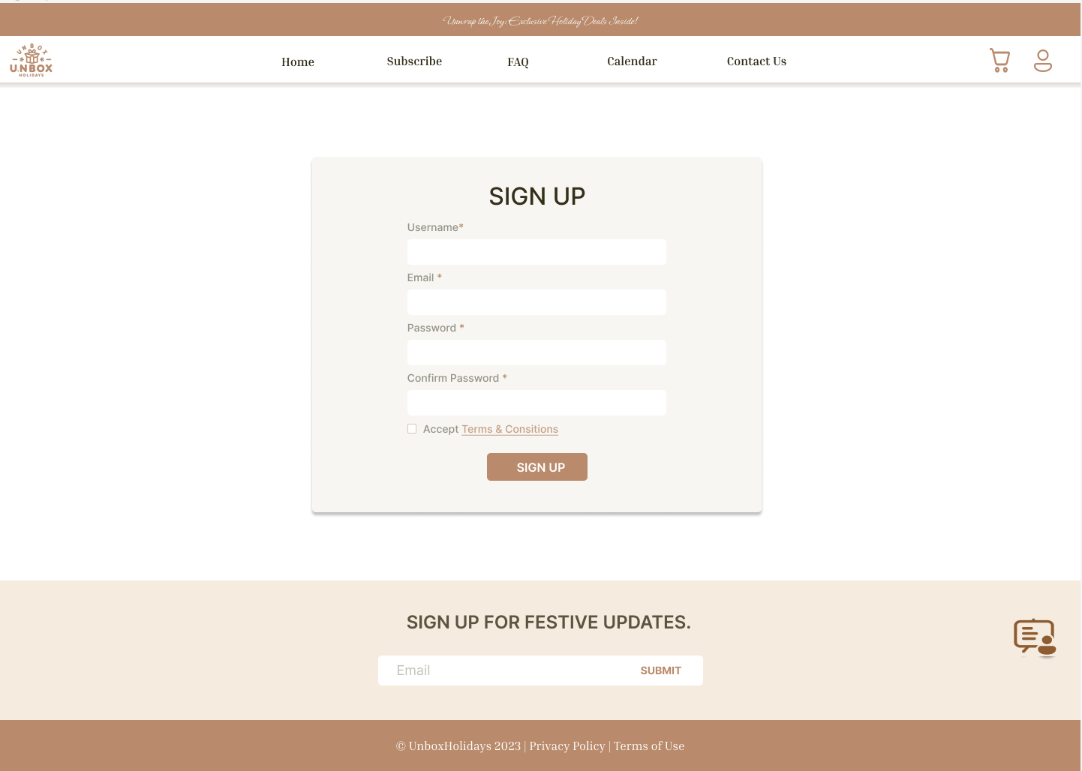
Sign Up Page
If you're new to Unbox Holidays, the signup procedure is equally user-friendly, allowing you to create an account effortlessly.

Slide 10
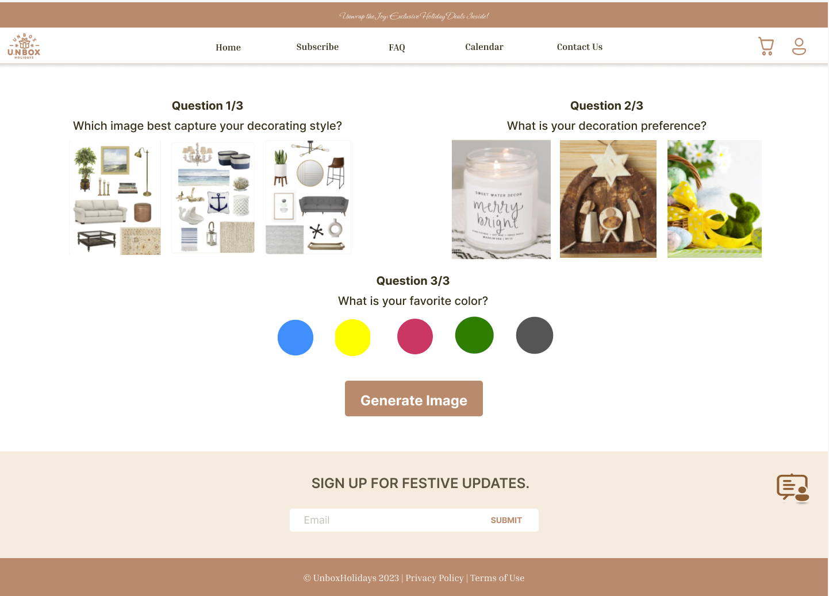
Questionnaire Page
The questionnaire page is the starting point of our subscription process. Here, users fill out questions about their decoration preferences, such as style, colors, and themes.
This straightforward process ensures each holiday box we send is customized to match their personal tastes, making every unboxing a unique and enjoyable experience.

Slide 11
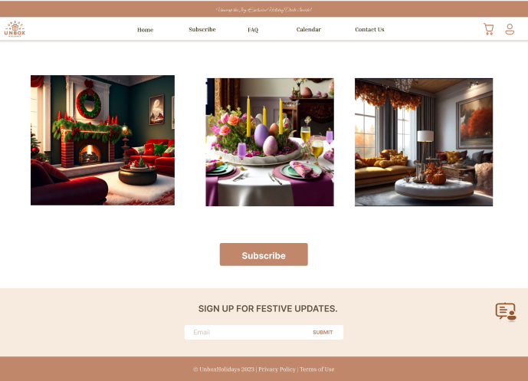
Our FAQ page offers detailed insights on how 'Unbox Holidays' works, along with clear information on shipping and billing. It's tailored to quickly answer key questions, streamlining the understanding of our processes and procedures for users.
Subscribe Page
After completing the questionnaire, users can click the 'Generate Image' button, leading them to the next phase of the subscription process.
Here, they'll see AI-generated images showcasing potential decorations based on their preferences. If satisfied with the preview, they can proceed to subscribe by clicking the 'Subscribe' button, finalizing their personalized holiday decoration journey.

Slide 12
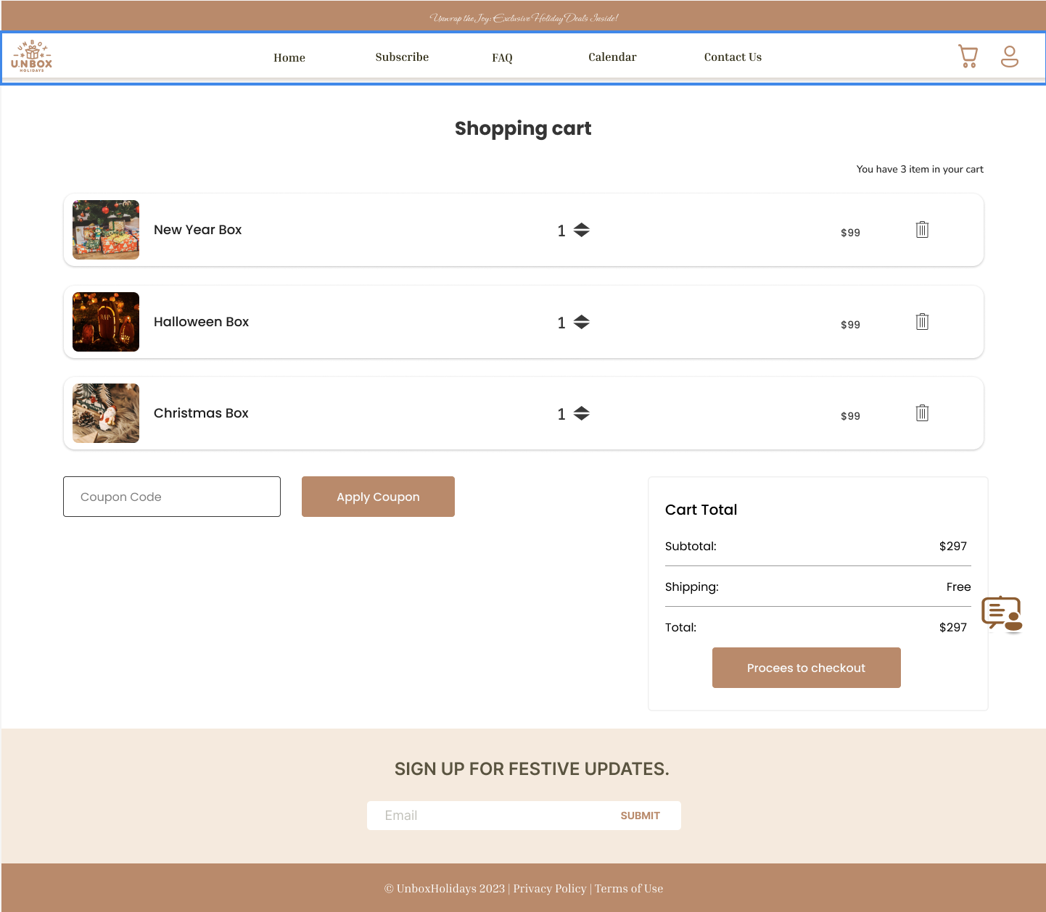
Shopping Cart Page
In the shopping cart page, the user can manage their selection of holiday decoration blind boxes before proceeding to checkout. Also, users can apply coupon code for discount and check the shipping value.
Once the user is satisfied with their holiday boxes, our secure payment processing system takes center stage.

Slide 13
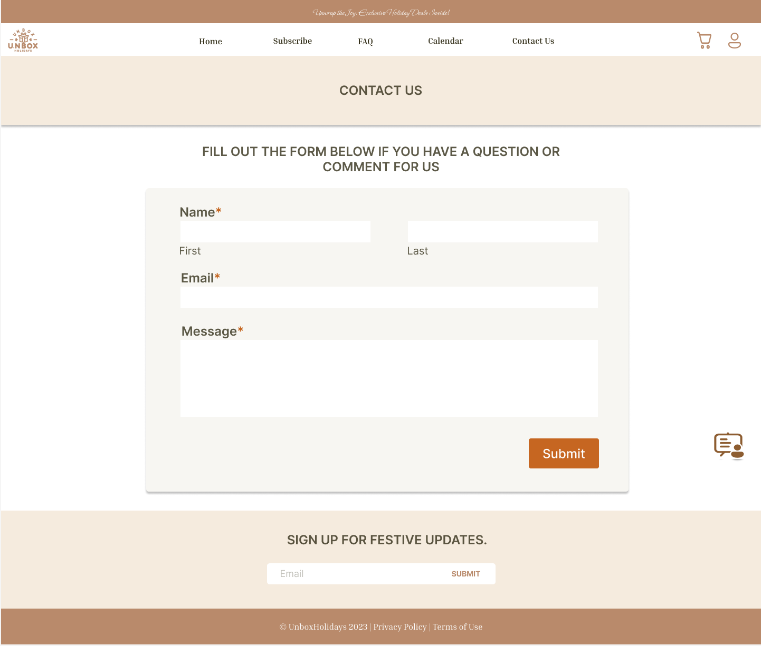
Contact Us Page
Contact Us page is the direct gateway to connecting users with our team. It is important to users have a space to share their questions, feedback, and comments.
Our Contact Us page is designed to make reaching out to us as delightful and straightforward as possible.

Slide 14
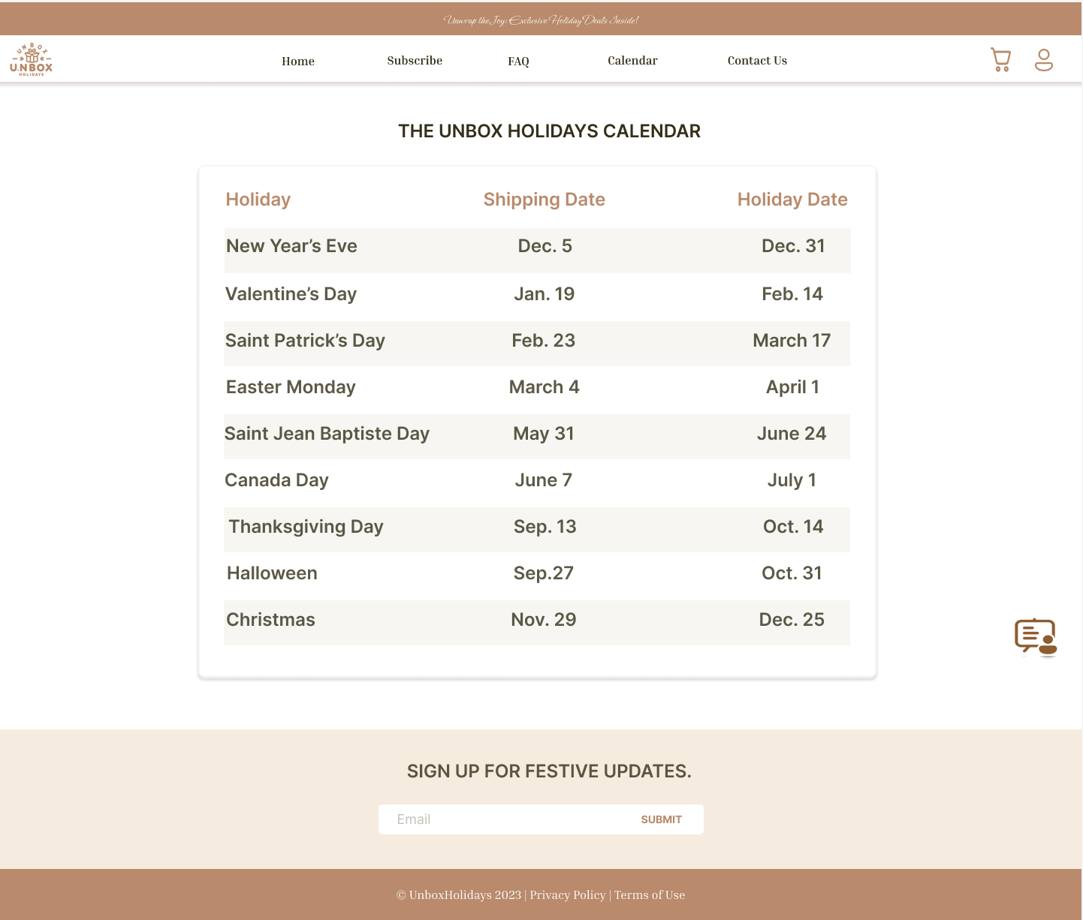
Calendar Page
The Calendar page is a user-friendly calendar page for keeping track of important dates, and special events related to Unbox Holidays.
The user can discover exciting holiday-themed events and check the shipping date for their boxes.

Slide 15
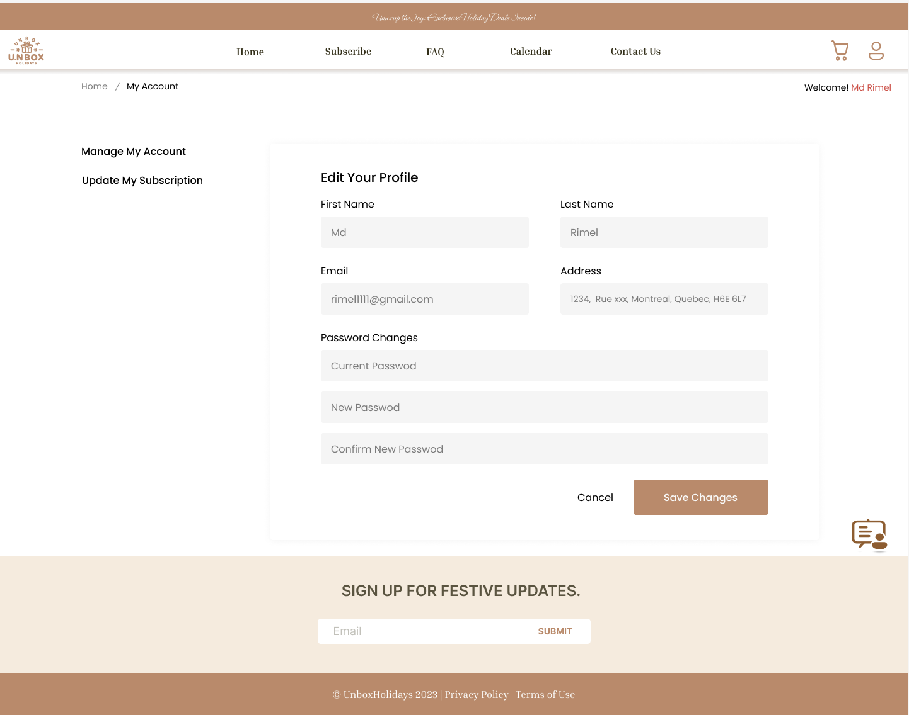
User Profile Page
The user profile page allows users to update their personal information including their names, email address, password, and physical address as well as users can update their subscription plan through this page.

Slide 16
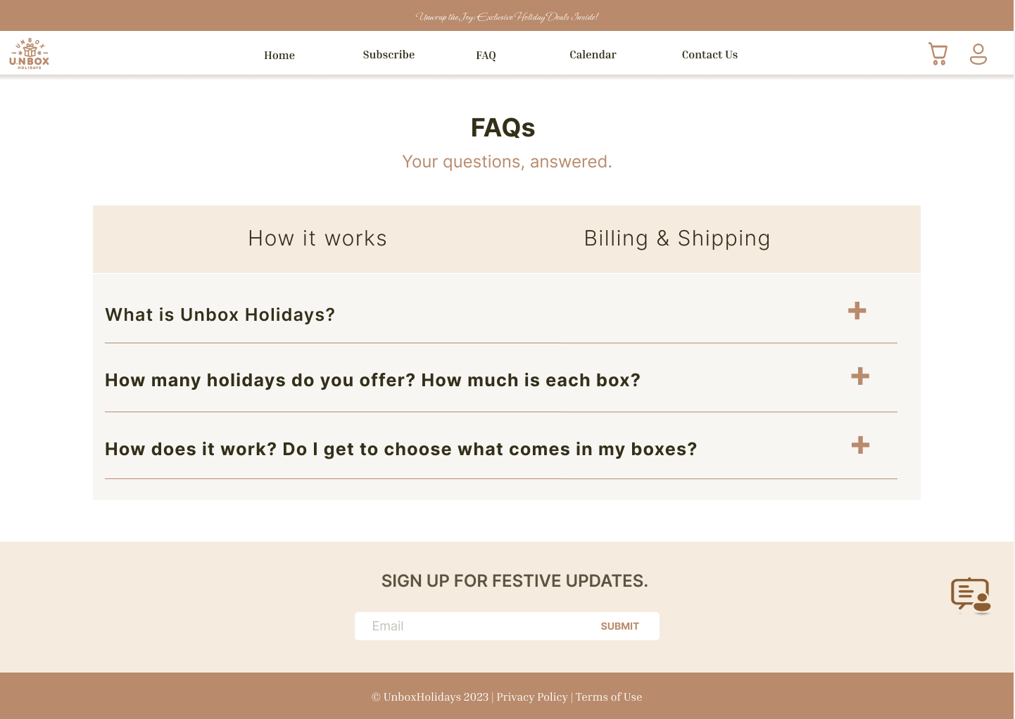
FAQ Page
Our FAQ page offers detailed insights on how 'Unbox Holidays' works, along with clear information on shipping and billing.
It's tailored to quickly answer key questions, streamlining the understanding of our processes and procedures for users.

Slide 17
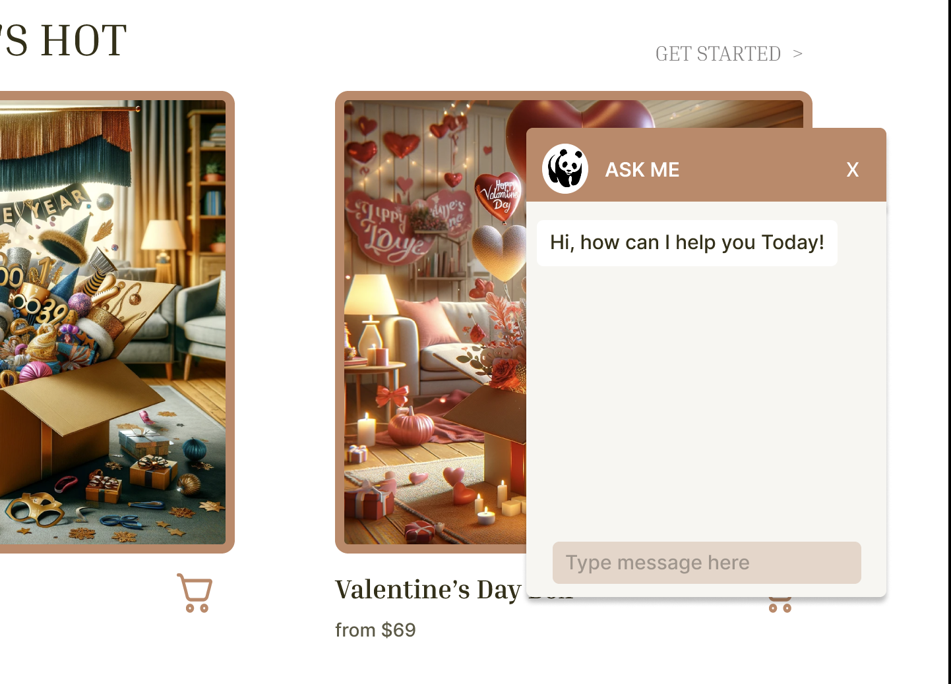
ChatBot
Our chatbot is a user-friendly feature on our website, offering instant assistance for inquiries about our products and subscription process.
It's designed to provide efficient and accurate responses, enhancing the user experience and simplifying navigation and information gathering on our site.

Slide 18

GitHub Link
https://github.com/adinashby-vanier-college/transactional-web-project-Belal-Mohsen.git

Slide 19


